Slide 1

Adventures in Deploying Private PaaS on the Open Cloud: Tales from the Enterprise

Slide 2
Agenda
Who is ActiveState?
What is PaaS?
What is the Open Cloud?
The Adventures in Deployment …
Notes:
“””Open cloud frameworks offer flexible, convenient infrastructure options for the real-world enterprise. But enterprise cloud deployments require security, application portability, and agility to handle the accelerated (and shortening) workload lifespans today’s IT demands.
Discuss the challenges, drama, and realities of deploying private Platform as a Service (PaaS) on OpenStack and CloudStack.
Come learn how to run production auto-scaling deployments across multiple stacks (OpenStack, CloudStack), multiple cloud frameworks, (private, public, hybrid), and multiple providers (like HP Cloud Services). Jeff and Diane will offer perspective and insight into the evolution of Open Clouds as a viable private cloud option, and as a most excellent host for Platform as a Service. The presentation will also cover lxc containerization, Ubuntu migration from 10.x to 12.x, deploying Hybrid Clouds with jcloud & brooklyn, and other aspects of the evolving Open Cloud eco-system.”””
Nothing beyond the content I used in my blog post(s) on Hybrid Cloud, CloudStack and OpenStack;
Yes we can speak to jclouds & brooklyn
I would propose the following outline:
Who Is ActiveState
What is Stackato
Describe Stackato's OS roots: Cloud Foundry, and any OS tools like doozer etc that you use to make it sing under the hood
Our Goal: To make it ready to run on Any Cloud (VMWare, AWS Sandbox were given)
Dec 2011 - joined OpenStack, created our first OpenStack Stackato Cluster
Our OpenCloud approach driven by customer/partner demand
1) KJ's work creating an OpenStack testing ground for Stackato (and what if any issues your team found)
2) OpenStack on HPCS:
3) CloudStack: Diane's DIY Blog Post approach
4) Hybrid Cloud: Review Alex's Video and talk about how and why you'd do this with jclouds/brooklyn
What we learned, what we liked, what's missing
>CTO's thoughts on the State of OpenCloud
Next Up?
> OpenNebula
> Auto-scaling on CloudStack?

Slide 3








About ActiveState
Founded 1997
2 million developers, 97% of Fortune 1000
ActiveState empowers innovation from code to cloud smarter, safer, and faster
Some customers:
Notes:
3

Slide 4
What is Platform as a Service?
Quoth the internets (wikipedia):
  Platform as a service (PaaS) is a category of cloud computing services that provide a computing platform and a solution stack as a service. Along with SaaS and IaaS, it is a service model of cloud computing. In this model, the consumer creates the software using tools and libraries from the provider. The consumer also controls software deployment and configuration settings. The provider provides the networks, servers and storage.
Why do you care?
  This is the future of development
Stackato is private PaaS

Slide 5
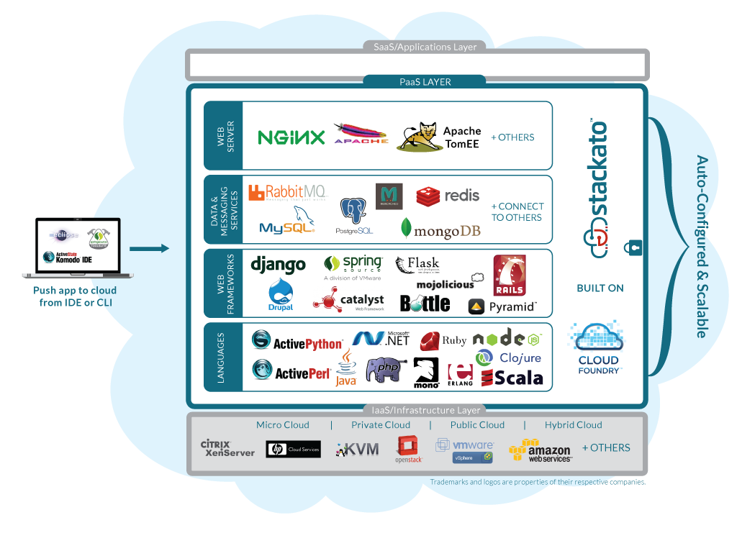
Multi-Choice, End-to-End, Portable

Slide 6
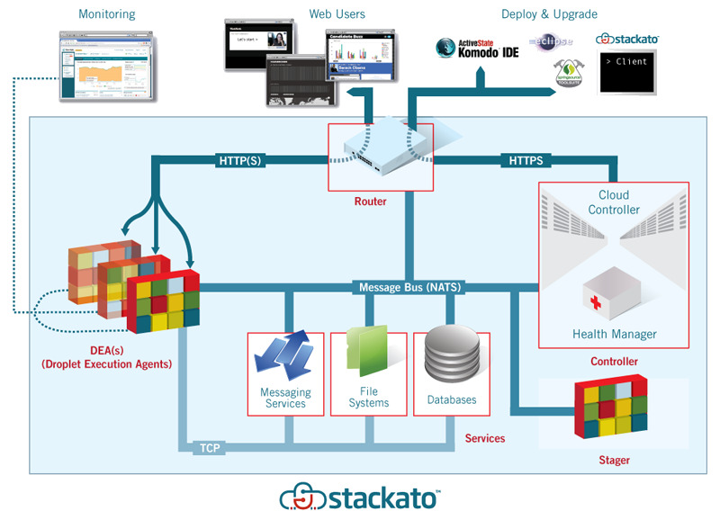
The Stackato Architecture

Slide 7
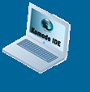
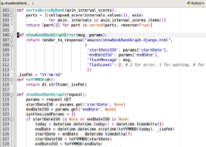
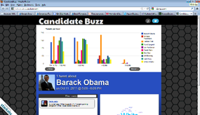
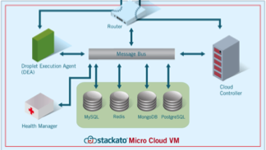

The Stackato Deployment Model
Deployed to the Cloud
Your App
Client (IDE or Command Line)
Stackato VM
+
+
=

Slide 8
How did we get here?
Started with custom language distributions
Getting Python into the cloud … (the ActivePython AMI)
Multipaas!
  Multi-languge, multi-cloud paas solution
  Support existing (legacy) application code
Phenona acquisition
Cloud Foundry

Slide 9

From Cloud Foundry to Stackato
Languages
Security
Ease of use
Ease of deployment
Any Language, Any Stack, Any Cloud™

Slide 10

What is the Open Cloud?
Referring to the all encompassing cloud
There are many options
  … many variations
  … and many installations
Open Source driving some
+ OTHERS

Slide 11
Enterprises moving to “Private” Clouds
Adoption 2012
Adoption 2015
Traditional
Virtualized
Private Cloud
Public Cloud

Slide 12
Where the Adventure Begins …
Let’s start simple

Slide 13
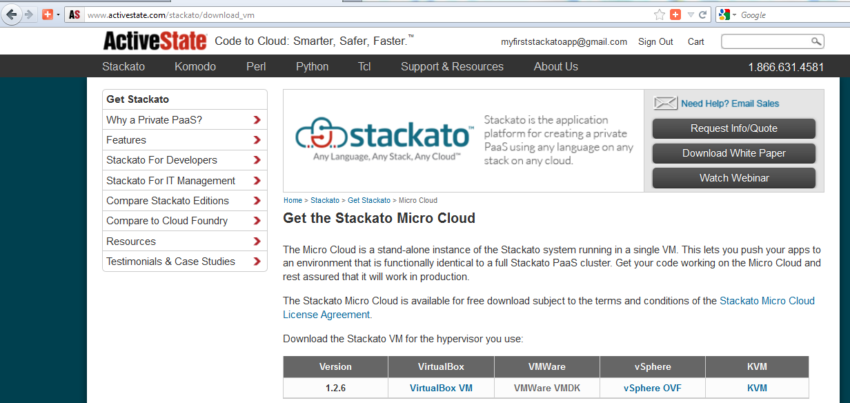
Stackato on CloudStack in 4 Steps
Step 1: Download Stackato!
  http://www.activestate.com/stackato/download_vm

Slide 14
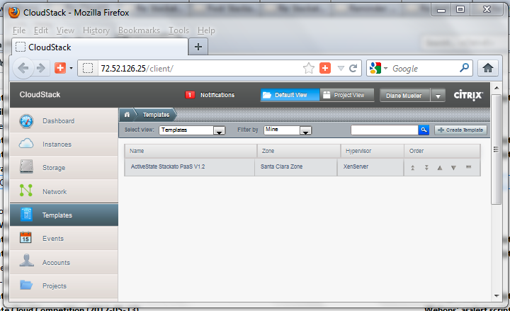
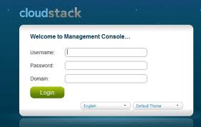
Log In To Cloudstack

Slide 15
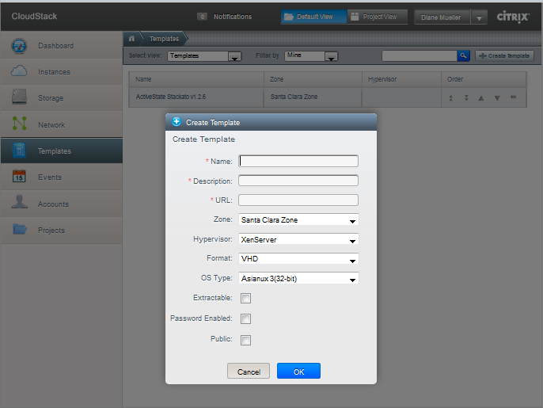
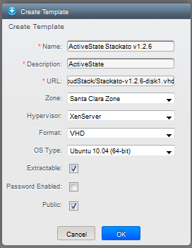
Step 2: Create A Template

Slide 16
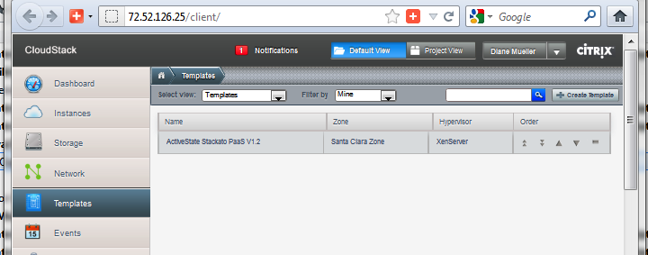
45 minutes later…Uploads take Time!

Slide 17
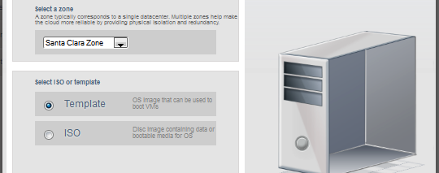
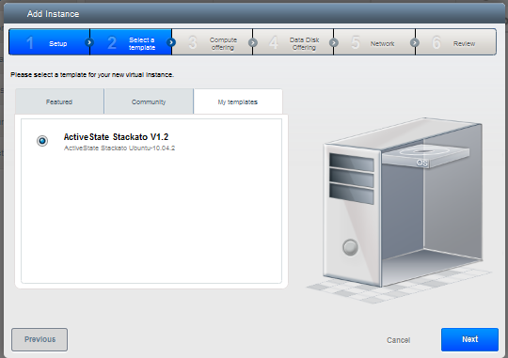
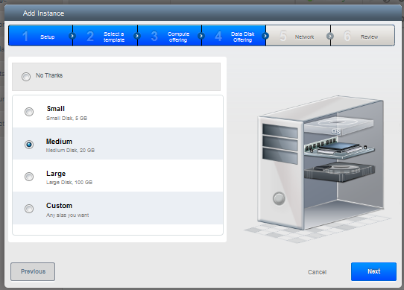
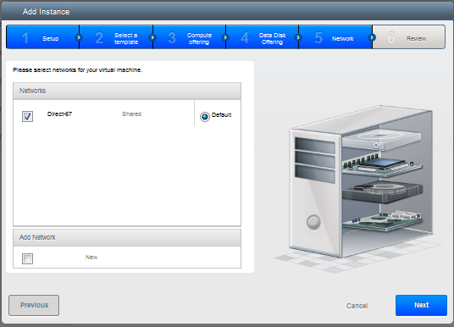
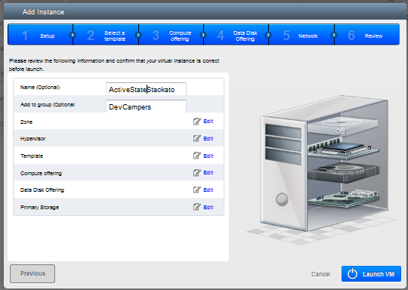
Step 3: Create an Instance
Nice Wizard!

Slide 18
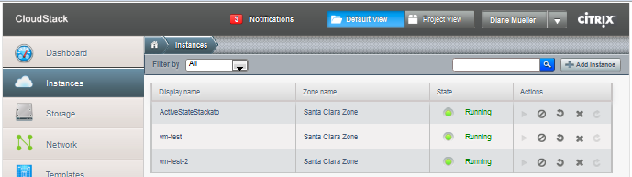
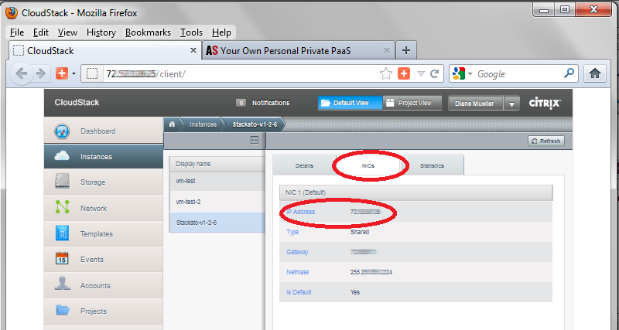
Look Up the instance’s IP Address & configure Stackato..

Slide 19
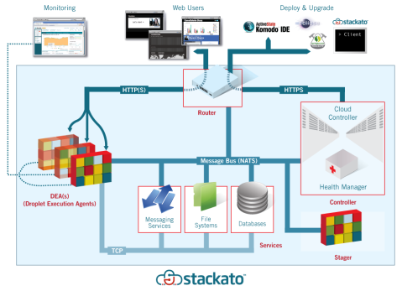
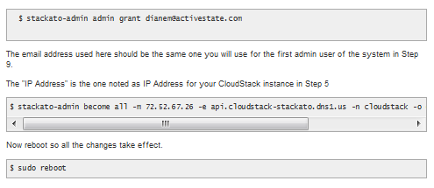
Step 4: Become “Stackato”
stackato-admin commands

Slide 20
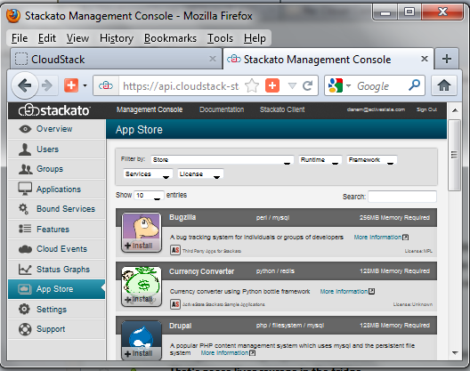
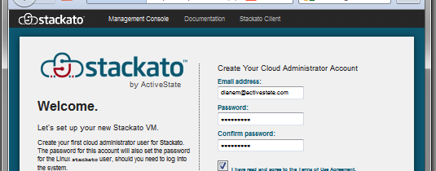
Log in to Stackato & Start Deploying

Slide 21
The Stackato Deployment Model
Deployed to the Cloud
Your App
Client (IDE or Command Line)
Stackato VM
+
+
=

Slide 22
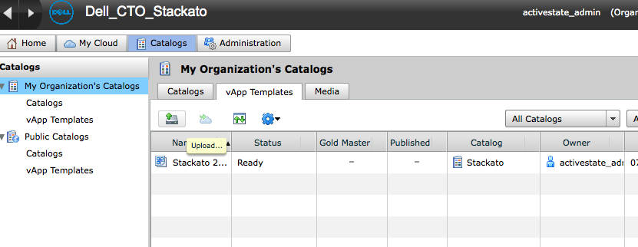
The Adventure Continues …
Importing the VM is step 1
Some methods are easier than others
Some allow this via their UI

Slide 23
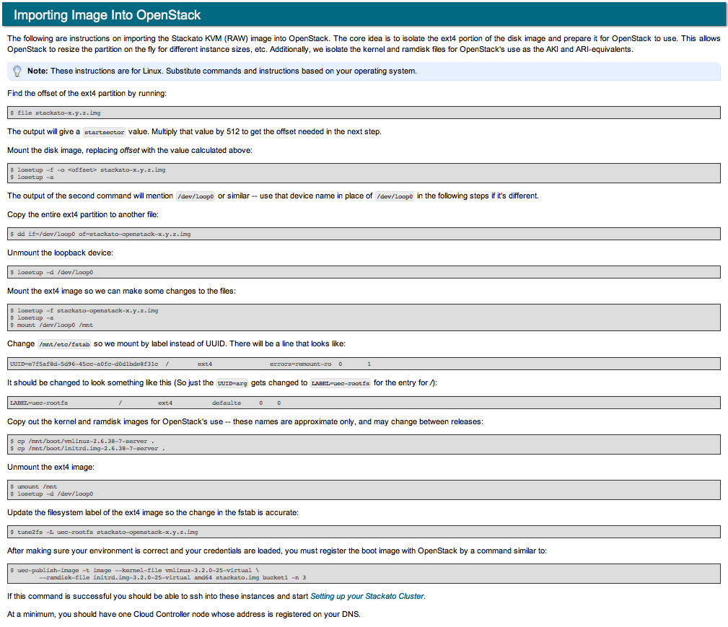
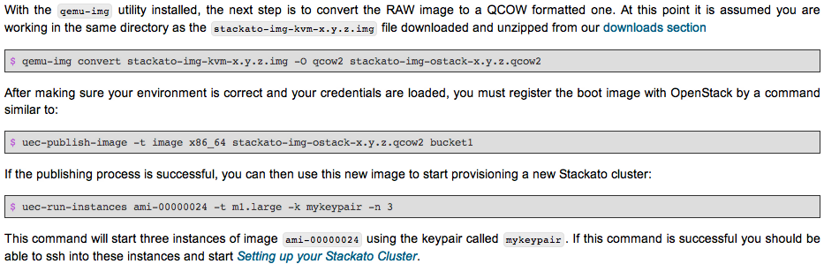
OpenStack in Stages
Not all import steps are short

Slide 24
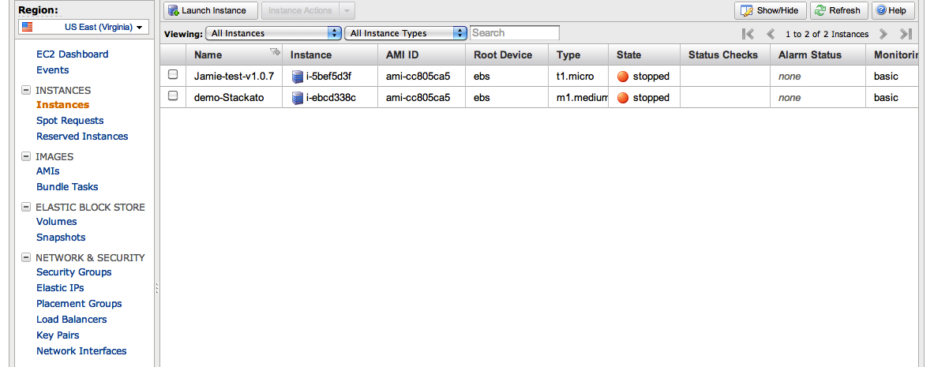
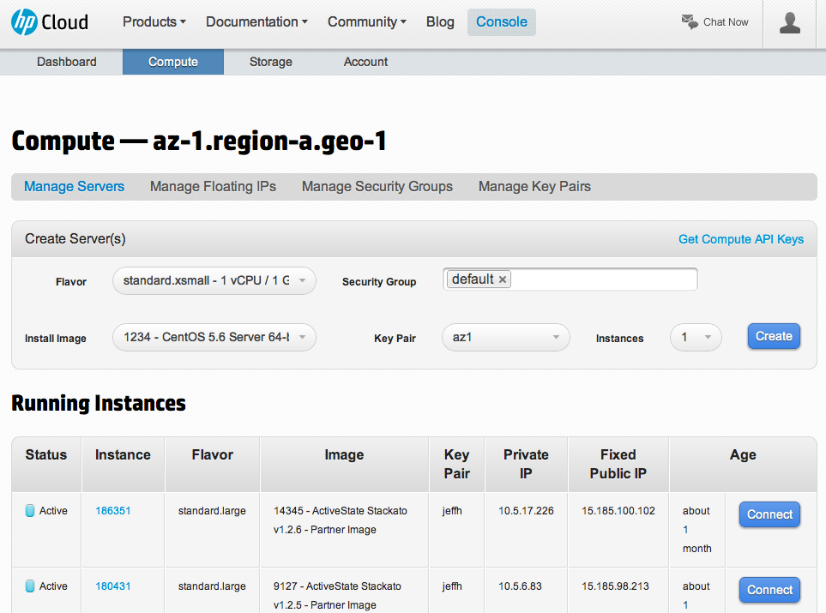
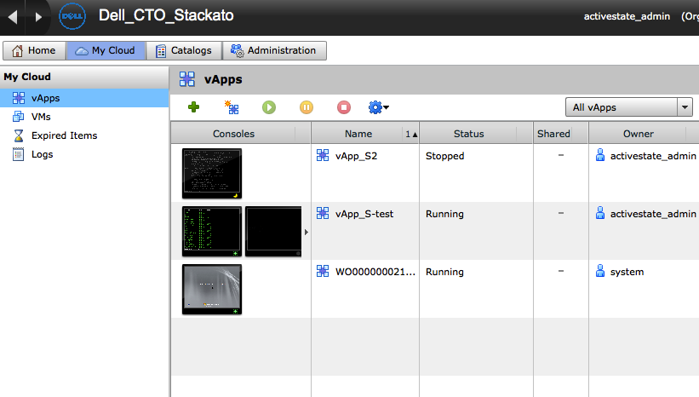
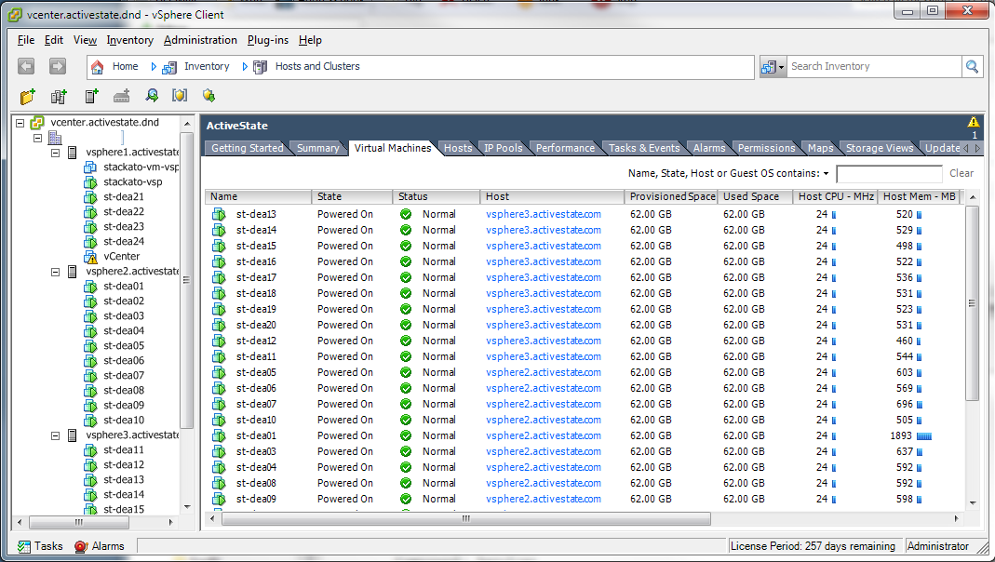
Images, images, everywhere

Slide 25
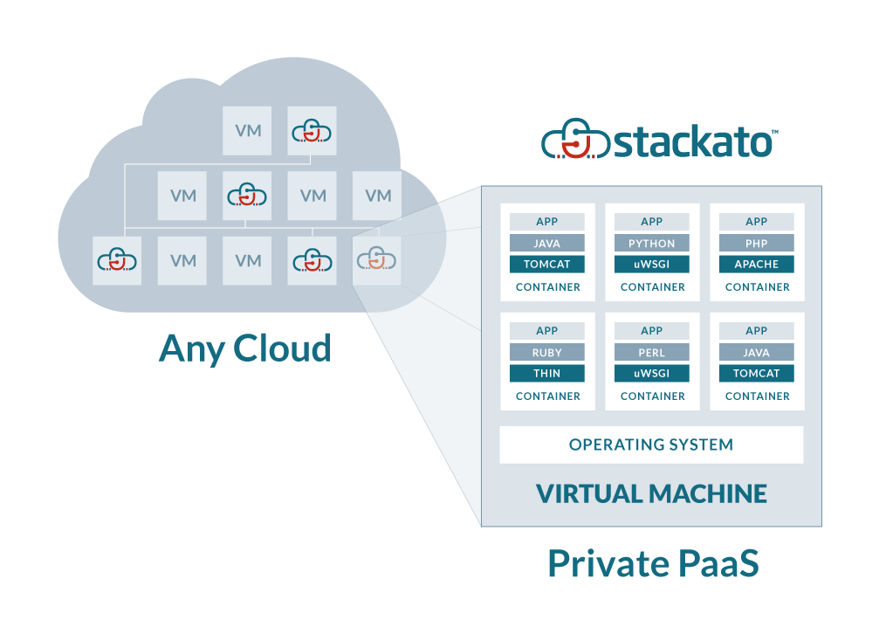
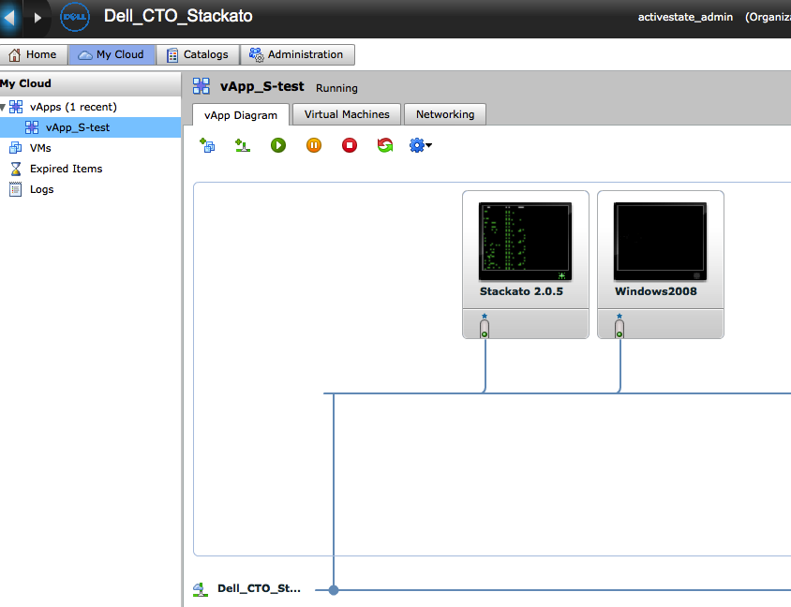
Supporting the Advanced Features
Clustering
  Network, network, network

Slide 26
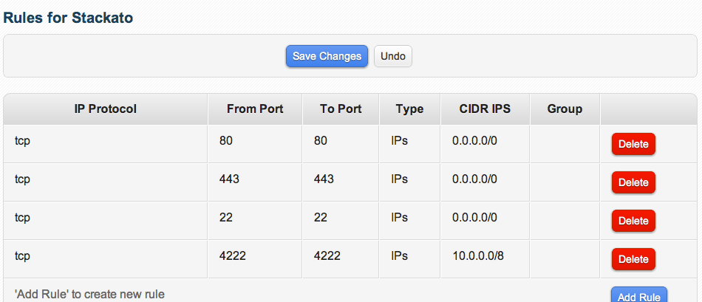
Supporting the Advanced Features
Clustering
  Network, network, network
  Secure the cluster!
  …but how?

Slide 27
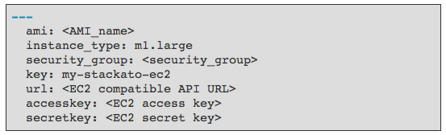
Supporting the Advanced Features
Auto-scaling
  Is the API fully supported?

Slide 28
What have we learned?
Not all systems are created equal
  Even if they have the same software
No 2 enterprises share the same exact standards for networking, application deployment or IT infrastructure
There is still work to bridge the Developer and Operations divide
Good docs save hours (days) of support time

Slide 29
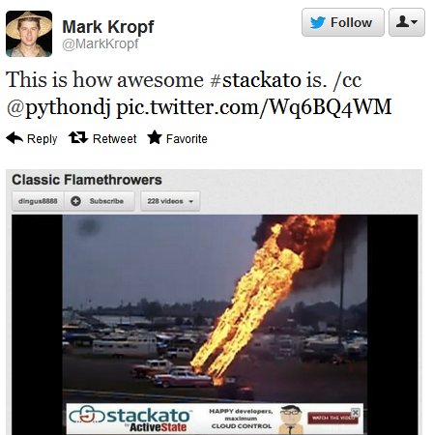
What People are Saying

Slide 30
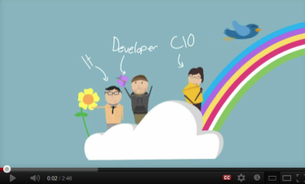
Thank you!
Try out the free Stackato 2.0 Micro Cloud:
activestate.com/stackato
Stackato, the movie:
http://www.youtube.com/watch?v=n_aKBJNovdU
Twitter: @activestate, #stackato activestate.com/blog

Slide 31
Appendix Screenshots

Slide 32
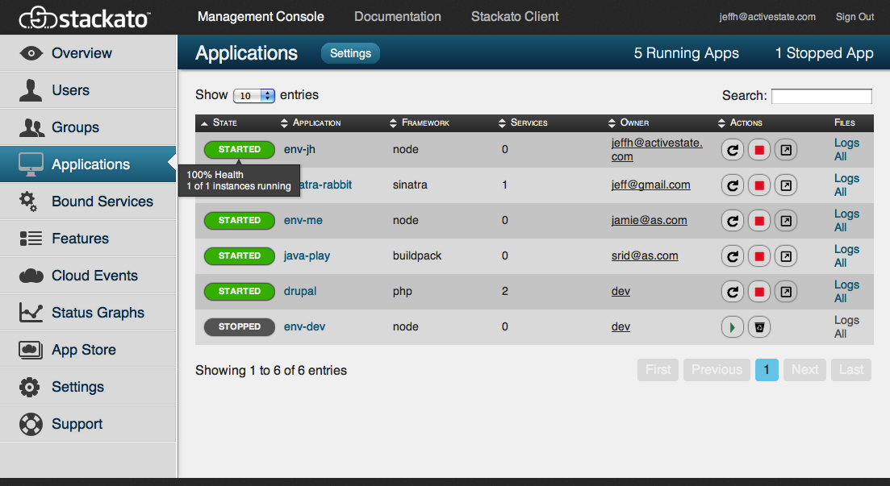
The Stackato Management Console provides a detailed view of your cloud applications

Slide 33
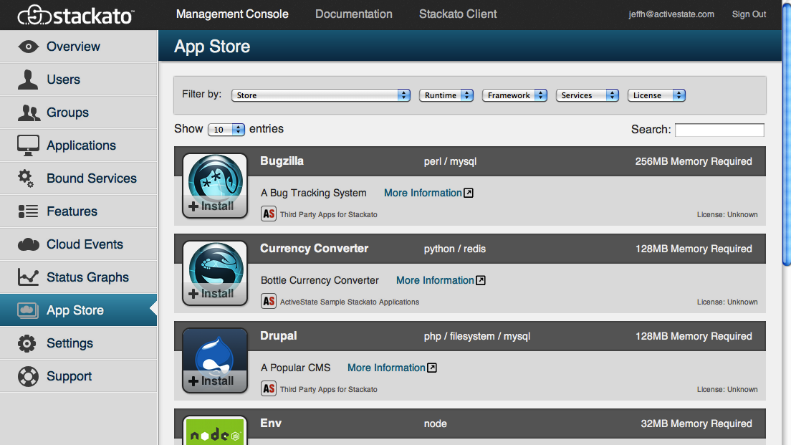
Stackato includes its own App Store framework

